Slide 1
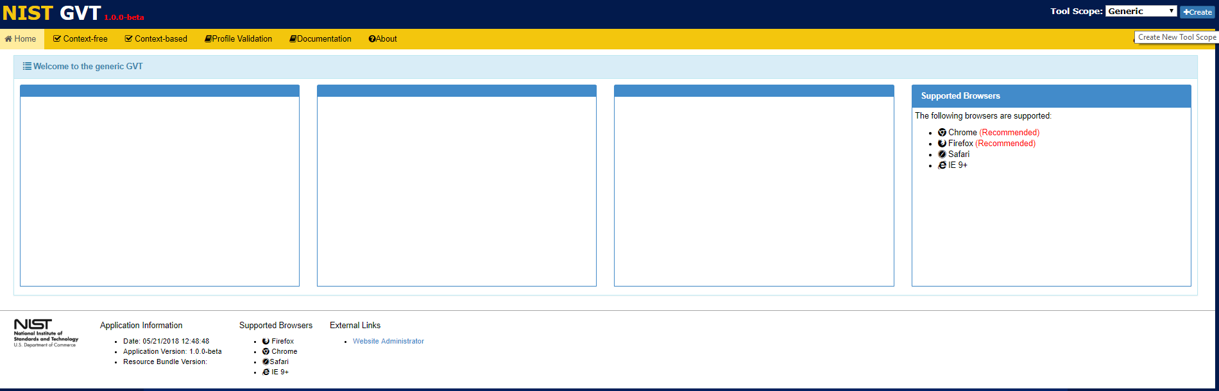

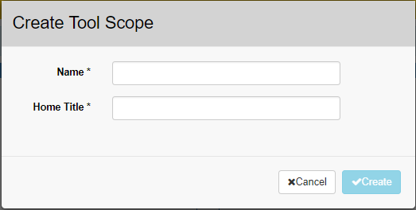
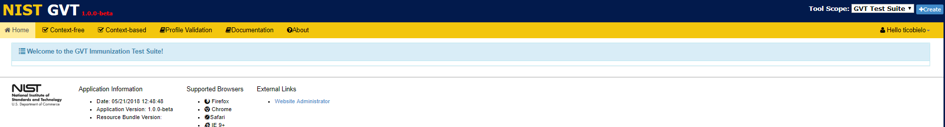
Creating a Tool Scope
The Tool Scope is used to organize testing tools into user-defined categories.
Any name that indicates the category of the tools being created can be applied to a Tool Scope. Tool Scope mostly is relevant for organizing Public tools available for use by all GVT Users, but is still needed for organizing Private tools available for use only by the registered GVT User who created the tools.
1
Click +Create.
Enter Tool Scope Name and Home Title
3
Click √Create.
2
4
Tool Scope Name and Home Title are displayed.

